Slide 1
Dr. Konstantinos Tselios, MD, PhD
Assistant Professor

Slide 2
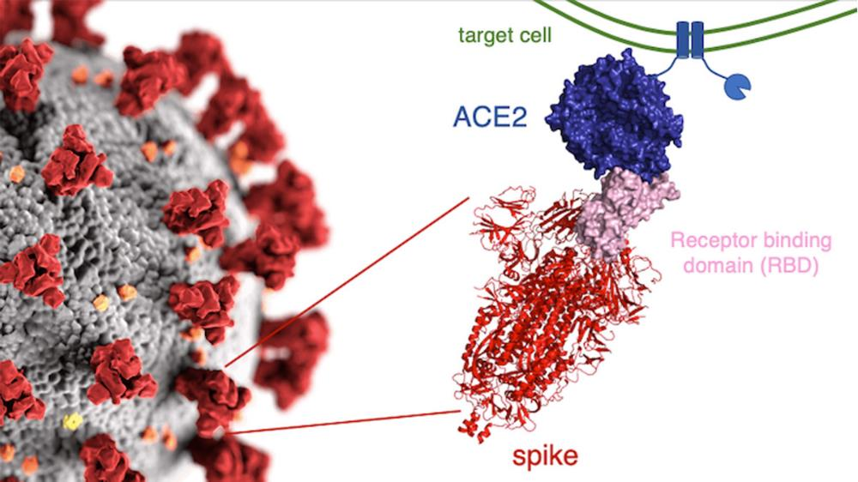
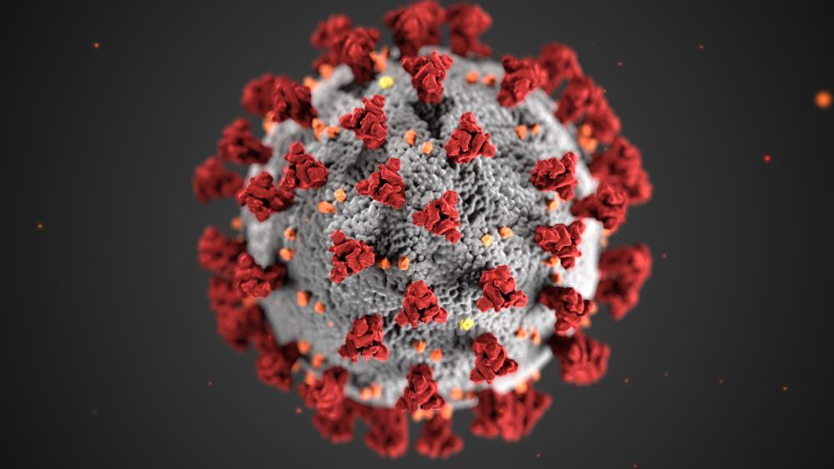
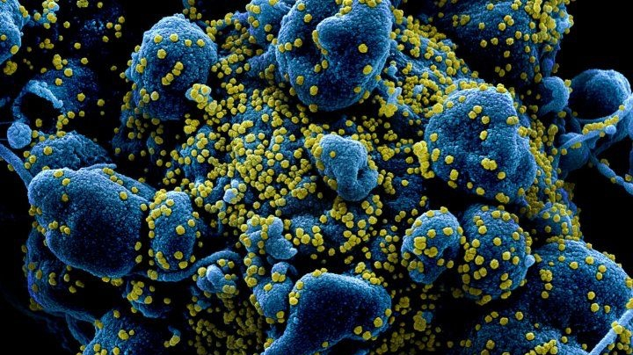
What is this ”coronavirus”?

Slide 3
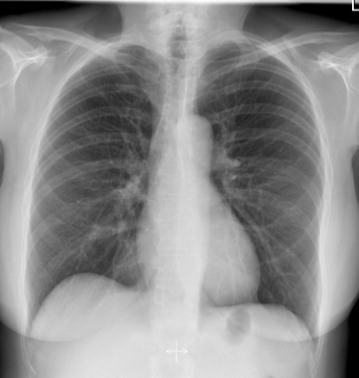
Chest X-ray (normal vs. COVID-19)

Slide 4
Chest CT (normal vs. COVID-19)

Slide 5
Canada
(up to April 19, 2021)
Cases: 1,131,773
Deaths: 23,667
CFR: 2.1%

Slide 6
What’s happening in Ontario?
Up to April 19, 2021
Cases: 421,442
Deaths: 7,735 (1.84%)
Hospitalized: 2,202
ICU: 755
Ventilator: 516

Slide 7
March 2020 Early effects (when we knew nothing…)
Hydroxychloroquine may be active against the new virus
Hydroxychloroquine (Plaquenil®) shortage / increase in illness uncertainty (anxiety and emotional distress)
Stress is related to impaired regulation of the immune system and higher likelihood of flare
IHU Mediterranee (Dr. Raoult)
5432 patients treated with HCQ+AZI for >3 days
15 died (0.3%)
Peschken C. J Rheumatol 2020

Slide 8
The first Canadian report (May 2020)
134 rheumatologists across the country were contacted regarding HCQ shortages
60% of them had been contacted by patients or pharmacies for HCQ shortages
94% in Quebec / 50% in the rest of Canada
Approximately 50 patients per physician were affected by HCQ shortage in Quebec (4 in the rest of Canada)
Mendel et al. Ann Rheum Dis 2020

Slide 9
April 2020
No lupus patients with COVID-19 worldwide?
Joob & Wiwanitkit. Ann Rheum Dis 2020

Slide 10
May 2020: the first cases
1st SLE patient with COVID-19 to be reported in the literature (China)
47y old female with lupus for 16 years / taking prednisone 7.5mg/day
Mild symptoms after 14 days but bilateral pneumonia on CT
Recovered after 9 days with antibiotic treatment
2nd lupus patient with a kidney transplant (Turkey)
28y old female, received a kidney transplant from her mother 6 months ago
Mild disease without pneumonia
Recovered after a few days
Han et al. Clin Immunol 2020
Arpali et al. Transpl Infect Dis 2020

Slide 11
COVID-19 Global Rheumatology Alliance
110 patients with rheumatic diseases
19 with SLE
A few weeks after…
80 lupus patients were reported by the Alliance
64% on HCQ
No effect of HCQ on risk of hospitalization or ICU
Gianfrancesco et al. Lancet Rheumatology 2020
Konig et al. Ann Rheum Dis 2020

Slide 12
June 2020: the first case series (France)
17 patients with SLE and long-term HCQ treatment
Age 53.5, disease duration 8.2
Co-morbidities: obesity (10/17), CAD (2/17)
HCQ 100% (compliant), Prednisone 7/17, Immunosuppressives 7/17
Hospitalized:14/17
ICU: 7/17
Death: 2/17
Mathian et al. Ann Rheum Dis 2020

Slide 13
Are SLE patients at increased risk of contracting SARS-CoV-2?
No (Italy, 55.000 patients)
Yes (meta-analysis of 62 studies/319.025 patients with autoimmune diseases)
HR=2.19 (95%CI=1.05-4.58)
Murtas et al. Auto Immun Highlights 2020
Akiyama et al. Ann Rheum Dis 2020

Slide 14
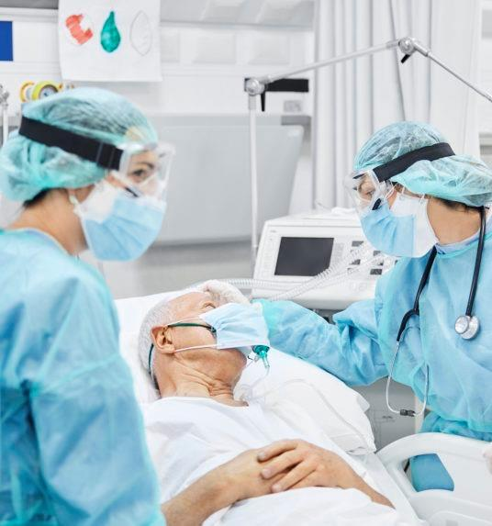
Are SLE patients at increased risk of hospitalization?
600 patients from the Alliance (85 with SLE)
46% hospitalized
Prednisone >10mg/day doubled the risk
No additional risk for common immunosuppressives
No additional risk for anti-TNFs
Other factors
Age>65 (x2.5), hypertension or cardiovascular disease (x1.85), lung disease (x2.5), diabetes (x2.6)

Slide 15
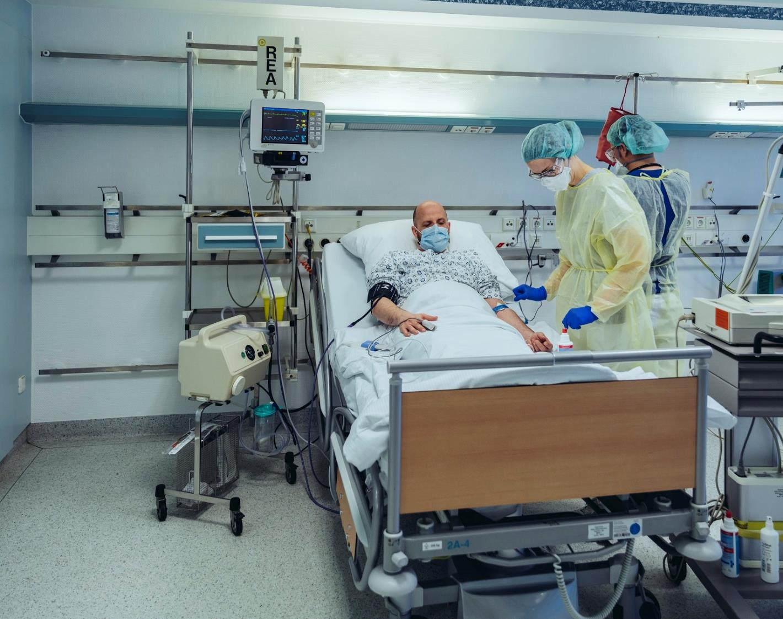
Are SLE patients at increased risk of hospitalization?
456 patients from Spain
74% hospitalized
1.82 times to get admitted
Age >65 (x4.8), males (x1.8)
Meta-analysis 65 studies/2766 patients with autoimmune diseases
Hospitalization: 35%
Pablos et al. Ann Rheum Dis 2020
Akiyama et al. Ann Rheum Dis 2020

Slide 16
Hyrich & Machado. Nat Rev Rheumatol 2021

Slide 17
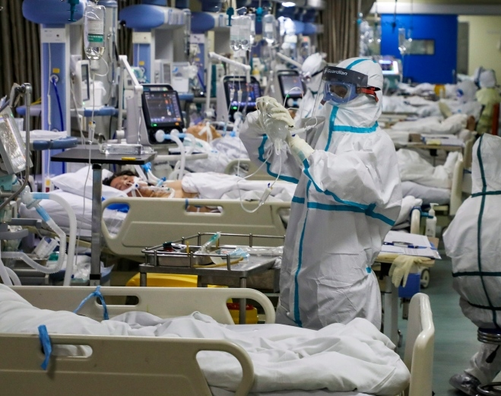
Are SLE patients at increased risk of ICU admission?
3 times higher risk for ICU if hospitalized
Risk factors: non-White race, obesity, history of LN, cardiovascular disease
D’Silva et al. Ann Rheum Dis 2020
Fernandez-Ruiz et al. Arthritis & Rheumatology 2020

Slide 18
Are SLE patients at increased risk of death?
Meta-analysis of 65 studies
2766 patients with autoimmune diseases
Mortality: 6.6%
Akiyama et al. Ann Rheum Dis 2020

Slide 19
Mageau et al. Ann Rheum Dis 2021

Slide 20
Does SARS-CoV-2 triggers flares in SLE?
First case September 2020
62y old male
Developed Evans syndrome (anemia, thrombocytopenia)
Unfortunately passed away 14 days after his admission
Raghavan et al. J Clin Rheumatol 2020

Slide 21
Does SARS-CoV-2 triggers autoimmunity and SLE?
First case in July 2020 (USA)
18y old female with severe COVID
Developed thrombotic thrombocytopenic purpura and lupus nephritis after a few weeks in the ICU
Unfortunately passed away
Up to last week, there were 6 cases of lupus after COVID-19 (Morocco, Italy, Iran, Mexico)
Cardoso et al. Clin Rheumatol 2020

Slide 22
Impact on patients
101 patients with LN were conducted by telephone in China
60% missed their appointments
13% had an online/telephone consult
25% discontinued medications (half because of
limited access to healthcare)
5% developed a flare
Chen et al. J Rheumatol 2020

Slide 23
Impact of the first wave of the pandemic on lupus patients
Italy (332 patients)
6 contracted the virus (all mild cases)
11.1% discontinued therapy
8.1% flared
Zuchi et al. PLoS One 2021

Slide 24
Mental health of SLE patients during the pandemic
134 lupus patients / 589 non-lupus patients
Anxiety (x 3.7)
Depression (x 4.2)
Insomnia (x 6.8)
Wankowicz et al. J Clin Med 2020

Slide 25
GSI: Global Severity Index, PS: Total Positive Symptoms, PSDI: Positive Symptomatic Distress Index
Santos-Ruiz et al. Med Clin (Engl Ed) 2021

Slide 26
The UK experience of lockdown
I felt afraid and quite panicked, which led to a massive flare, which lasted 6 weeks.. . . I don’t know if I will ever feel safe again. (Participant 132, 40–49 years old)
Flaring badly . . . unable to get hold of my rheumatology team to
help me . . . much more depressed than I was before the coronavirus
outbreak. This is partly due to isolation from friends and family
but also because I have felt very vulnerable due to my inability to
get the medical support I have needed. (Survey, 40–49 years old)
We are a group of people who know how to deal with this. More
than most. We are all fighters who know our bodies better than anyone. (Participant 55, 40–49 years old)
Sloan et al. Rheumatol Adv Pract 2021

Slide 28
Viruses they are a changing…♫♫

Slide 32
Vaccinations in Canada (up to April, 10, 2021)
19.18% of the population have received one dose
2.13% of the population have received 2 doses
84.62% of people >80 have received at least one dose
96.68% of people leaving in group living settings for seniors have received one dose
89.72% of HCW have received one dose

Slide 33
Vaccine safety in Canada
Up to April 9, 2021
7,569,321 doses administered
3,444 total adverse events (0.045%)
464 serious adverse events (0.006%) OR 1 in 16,666 doses
*2 cases with vaccine-induced TTS (Quebec, Alberta)
More common in females 18-49 years of age

Slide 35
Boyarsky et al. Ann Rheum Dis 2021

